Slide 1
WELCOME PROGRAMMING WITH JAVA
WE ARE STARTING AT 10:00 A.M. GEORGIAN TIME

Slide 2
String, StringBuilder and Date based API’s
Simeon Angelov

Slide 3
Content
String
StringBuilder
String vs. StringBuilder
Date based API’s
Facts about the quiz

Slide 4




String
Object backed internally by a char array
Immutable – means whenever change is made, a new String instance is created
Syntax
<String_Type> <string_variable> = “<sequence_of_string>”;
String name = “Peter”;
How it looks in the memory an instance of a String:
String name = “Peter”
“Peter”
“Peter”
Constant String pool
Heap area

Slide 5
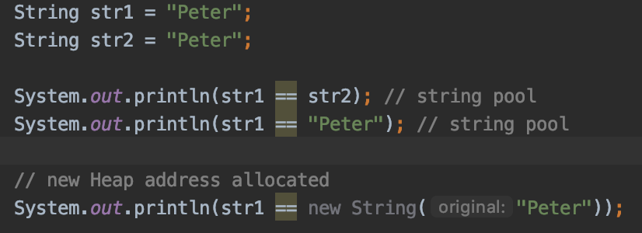
String
The characters array could be called via toCharArray()
Strings are stored in String Pool. JVM does not perform check in String Pool if it is created using new operator
equals() method is overridden in String class to compare string by its character value.

Slide 6
String
Backslash escape character (\) - turns special characters into string characters:
String name = “O\’Rally” // the value is “O’Rally”
String API:
char charAt(int index);
int compareTo(Object o);
boolean endsWith(String suffix);
int indexOf(int character);
and many many more …

Slide 7
String
length() – return number of characters
String string = ”hey";
System.out.println(string.length()); // 3
charAt() – return the character at specified index
String string = ”hey";
System.out.println(string.charAt(0)); // h
System.out.println(string.charAt(3)); // throws exception
indexOf() – find and return the first index that matches desired value
int indexOf(char ch) string.indexOf(‘h’)); -> 0 int indexOf(char ch, index fromIndex) string.indexOf(“e”, 1)); -> 1
int indexOf(String str) string.indexOf(“ey”)); -> 1 int indexOf(String str, index fromIndex) string.indexOf(“k”, 5) -> -1

Slide 8
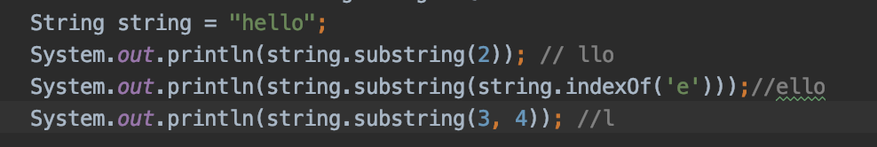
String
substring() – returns parts of a string starting from beginIndex inclusive and with optional endIndex exclusive
int substring(int beginIndex) int substring(int beginIndex, int endIndex)

Slide 9
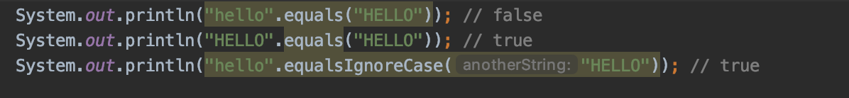
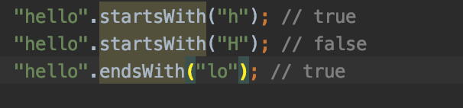
String
equals() and equalsIgnoreCase()
startsWith(String v) and endsWith(String v) – looks weather provided v args matches part of a string. Returns true if matches, false othwrwise

Slide 10
String
replace(): search and replace on the string provided
String replace(char oldChar, char newChar) String replace(CharSequence oldChar, CharSequence newChar)
trim() : remove white space (\t, \n, \r) from beginning and end of a string

Slide 11
String
Remember String is immutable
What is the result of the code bellow?
5: String a = "abc"; 6: String b = a.toUpperCase(); 7: b = b.replace("B", "2").replace('C', '3’);
8: System.out.println("a=" + a); 9: System.out.println("b=" + b);
Line 6 and 7 DO NOT change a
Line 7: b is “ABC” -> “A2C” -> ”A23”

Slide 12
StringBuilder
a mutable sequence of characters
Syntax:
StringBuilder str = new StringBuilder();
str.append("GFG"); // same instance has been changed
APIs:
StringBuilder append(X x):appends the string representation of the X type argument to the sequence, where X could be String, int, Boolean and many more
toString() return new instance of String copied of it’s characters

Slide 13
StringBuilder
APIs:
int capacity(): This method returns the current capacity.
char charAt(int index): returns the char value in this sequence at the specified index
StringBuilder delete(int start, int end): removes the characters in a substring of this sequence
StringBuilder replace(int start, int end, String str): replaces the characters in a substring of this sequence with characters in the specified String.
String substring(int a) or String substring(int a, int b) : This method returns a new String that contains a subsequence of characters currently contained in this character sequence
And many more

Slide 14
String vs StringBuilder
String | StringBuilder
Immutable | Muttable
Heavy strings operations | Use StringBuilder for string operations (contact, substract and etc …)

Slide 15
Date based API’s
Date – represents the current date and time
Constructors:
new Date() // instance of current date and time
new Date(long milliseconds); // instance of Date in milliseconds elapsed after midnight of January 1, 1970
Methods
boolean after(Date date) | True if this is later than date
boolean before(Date date) | True if this is earlier than date
int compareTo(Object date) | If date not date thows OCE, otherwise compare both
long getTime( ) | Return long represents the time elapsed since 1 jan 1970
void setTime(long time)

Slide 16
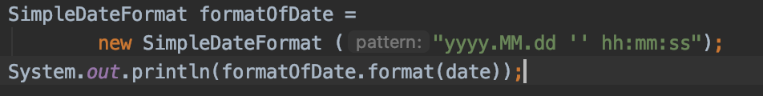
Date based API’s
SimpleDateFormat
Formats and parse the date being passed over
parse(String s), parse a string to a Date and returns it according to the format stored in the given SimpleDateFormat object
format(Date date), formats a dateinto a date-time string.
Syntax
Pattern letters: https://docs.oracle.com/javase/8/docs/api/java/text/SimpleDateFormat.html
Also valid:
Date date = new Date();
System.out.printf("%1$s %2$tB %2$td, %2$tY", "Due date:", date);

Slide 17
Date based API’s
MMMM – represents a month
M -> 1
MM -> 01
MMM -> Jan
MMMM -> January
dd – represents the date in month
yyyy – represent the year
yy - 2 dogits years
yyyy – 4 digits year
hh – represents the hours
: if you want to output a colon
mm – represents the minute

Slide 18
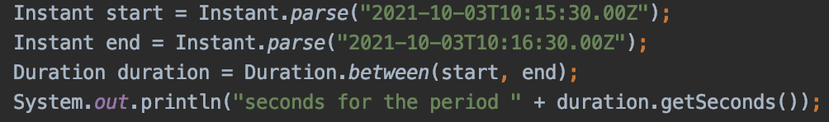
Date based API’s
LocalDate
Immutable date time object represents a date as 2021-02-20
LocalDate.of(2020,2,20);
Period
A date-based amount of time in the ISO-8601 calendar system, such as '2 years, 3 months and 4 days’.
Period.between(LocalDate.of(2021,4,10), LocalDate.of(2022, 4, 10));
Duration
represents an interval of time in seconds or nanoseconds

Slide 19
Date based API’s
LocalDate
a date in ISO format (yyyy-MM-dd) without time.
LocalDate localDate = LocalDate.now();
LocalDate.of(2015, 02, 20);
Provides various methods for it’s functionlaity:
LocalDate tomorrow = LocalDate.now().plusDays(1);
DayOfWeek sunday = LocalDate.parse("2016-06-12").getDayOfWeek();
int twelve = LocalDate.parse("2016-06-12").getDayOfMonth();
boolean notBefore = LocalDate.parse("2016-06-12") .isBefore(LocalDate.parse("2016-06-11"));
final – can not be extended
LocalDate.parse(CharSequence) method accepts String in "9999-99-99" format only. Single digit month and day value are padded with 0 to convert it to 2 digits.
So LocalDate date = LocalDate.parse("2018-1-01"); is wrong!

Slide 20
Date based API’s
LocalTime
represents time without a date.
Method signature of creating of instance with the 3 parameters
public static LocalDate of(int year, int month, int dayOfMonth)
LocalTime can be created from system clock or by using “parse” and “of” method.
LocalTime now = LocalTime.now();
LocalTime sixThirty = LocalTime.parse("06:30");
LocalTime sixThirty = LocalTime.of(6, 30);
LocalTime sevenThirty = LocalTime.parse("06:30").plus(1, ChronoUnit.HOURS);
int six = LocalTime.parse("06:30").getHour();
LocalTime maxTime = LocalTime.MAX -> 23:59:59.99:
final – can not be extended

Slide 21
Date based API’s
LocalDateTime
is used to represent a combination of date and time.
Afain using of of() and parse methods for creating it
LocalDateTime.of(2015, Month.FEBRUARY, 20, 06, 30);
LocalDateTime.parse("2015-02-20T06:30:00");
LocalDateTime.now();
localDateTime.plusDays(1);
localDateTime.minusHours(2);
final – can not be extended

Slide 22
Date based API’s
Using ZonedDateTime API
Used when we need to deal with time zone specific date and time. The ZoneId is an identifier used to represent different zones
ZoneId zoneId = ZoneId.of("Europe/Paris"); for Paris
Set<String> allZoneIds = ZoneId.getAvailableZoneIds(); all zones
ZonedDateTime zonedDateTime = ZonedDateTime.of(localDateTime, zoneId);
ZonedDateTime.parse("2015-05-03T10:15:30+01:00[Europe/Paris]");

Slide 23
Date based API’s
GregorianCalendar Class
implementation of a Calendar class that implements the normal Gregorian calendar
getInstance( ) method of Calendar returns a GregorianCalendar initialized with the current date and time in the default locale and time zone
GregorianCalendar(int year, int month, int date, int hour, int minute)
void add(int field, int amount) or int get(int field)
Date getGregorianChange()

Slide 24
Date based API’s
More about Periods
is widely used to modify values of given a date or to obtain the difference between two dates:
LocalDate initialDate = LocalDate.parse("2007-05-10");
Manipulated by Period like: LocalDate finalDate = initialDate.plus(Period.ofDays(5));
int five = Period.between(initialDate, finalDate).getDays();
Period period = Period.ofYears(-3000); is also valid – can accept negative number!
More about Duration
Similar to Period, the Duration class is use to deal with Time.
LocalTime initialTime = LocalTime.of(6, 30, 0);
LocalTime finalTime = initialTime.plus(Duration.ofSeconds(30));
Long thirty = Duration.between(initialTime, finalTime).getSeconds();

Slide 25
Date BASED API’s
 | Can call on LocalDate? | Can call on LocalTime? | Can call on LocalDateTime?
plusYears/minusYears | Yes | No | Yes
plusMonths/minusMonths | Yes | No | Yes
plusWeeks/minusWeeks | Yes | No | Yes
plusDays/minusDays | Yes | No | Yes
plusHours/minusHours | No | Yes | Yes
plusMinutes/minusMinutes | No | Yes | Yes
plusSeconds/minusSeconds | No | Yes | Yes

Slide 26
Data based API’s
Compatibility with Date and Calendar - via using of toInstant()
LocalDateTime.ofInstant(date.toInstant(), ZoneId.systemDefault());
LocalDateTime.ofInstant(calendar.toInstant(), ZoneId.systemDefault());

Slide 27
Demos
java-apis_demos_7

Slide 28
Facts about the quiz!
Strings are Immutable – means whenever change is made, a new String instance is created
Strings are stored in String Pool. JVM does not perform check in String Pool if it is created using new operator. So == is false for like new String(“Java”) == new String(“Java”)
public String substring(int beginIndex, int endIndex) where region starts from beginIndex but excludes endIndex: "hamburger".substring(4, 8) returns "urge”
Play around and know tiny pieces about any most used method of String and StringBuilder API
In StringBuilder the toString() methods return new String instance
StringBuilder.equals() method does not override the equals , means default == is used

Slide 29
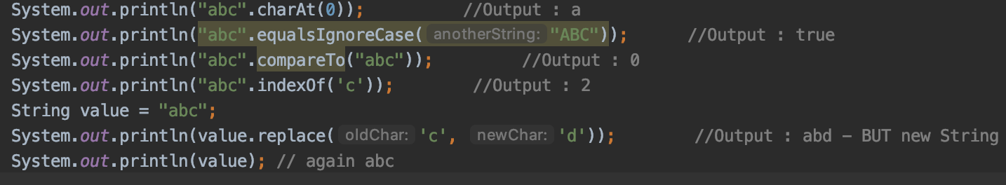
Facts about the quiz!
If you want to ignore case comparison of two strings consider using equalsIgnoreCase() method
String and StringBuilder are final. They can not be extended
equals() and hashCode() methods are overridden in String class but they are not overridden in StringBuilder classes
Some tries with String:

Slide 30
Facts about the quiz!
Understand the difference between == and equals()
== checks reference equality by memory allocation
equals() depends on the class implementation, by default checks equality by memory allocation. For String is by characters checks, where StringBulder does the default implementation

Slide 31
Facts about the quiz!
LocalDate, LocalDateTime and LocalTime are final – they can not be extended
LocalDate.parse(CharSequence) method accepts String in "9999-99-99" format only. Single digit month and day value are padded with 0 to convert it to 2 digits.
So LocalDate date = LocalDate.parse("2018-1-01"); is wrong!
Period period = Period.ofYears(-3000); is also valid – can accept negative number!
For LocalTime or LocalDateTime getSeconds() and. getMinutes() methods are with range 0 – 59
And many operations with java date based apis
Any others?

Slide 32
Facts about the quiz!
LocalDate does not contain time fields and LocalTime does not contain date fields
For LocalTime or LocalDateTime getSeconds() and. getMinutes() methods are with range 0 – 59
And many operations with java date based apis
Any others?

Slide 33
Exercises

Slide 34
Questions?
Notes:
Do you have any questions?

Slide 35
Thank You For Your Time

